Slide 1
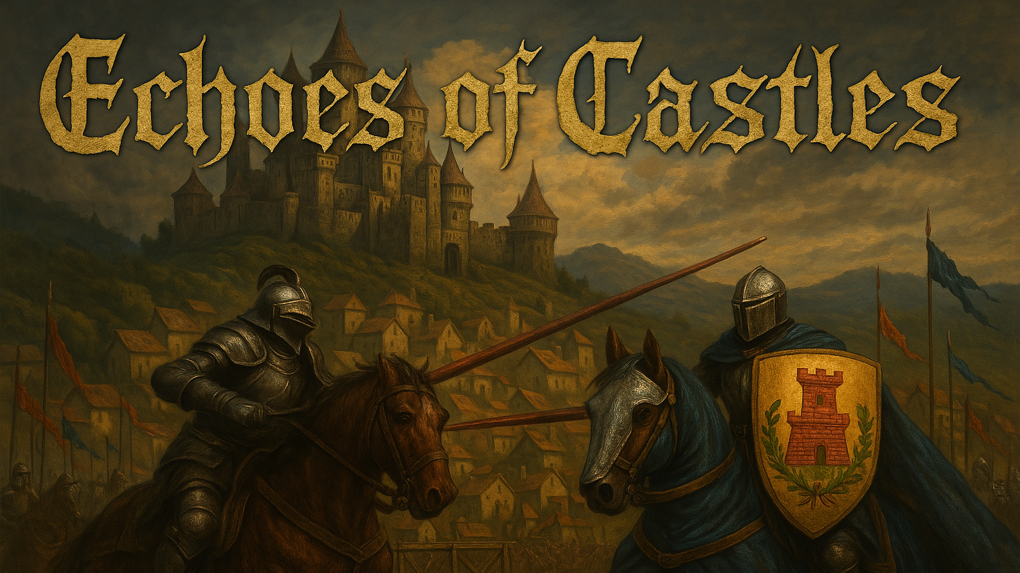

Slide 2
In a land torn by feuds and fading glory, where honor is as sharp as steel and alliances crumble like stone, only the boldest lords will rise. Rule your castle, forge fragile pacts, and ride into the deadly joust—where the fate of your people echoes louder than the clash of lances. Welcome to Echoes of Castles.

Slide 3
Game Sheet
Target RPG players
Management Games players
Genre RPG game
Management game
Action
Target Age 14+
Platform
PC
Main Tech Unity
Game mode Single Player

Slide 4
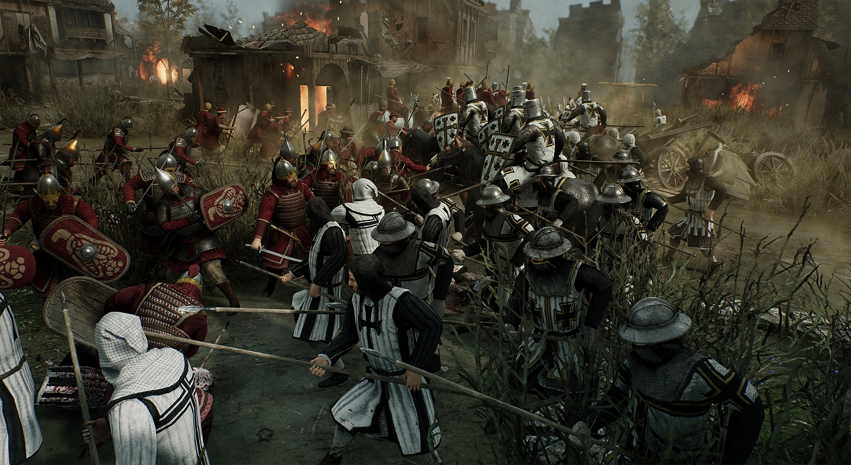
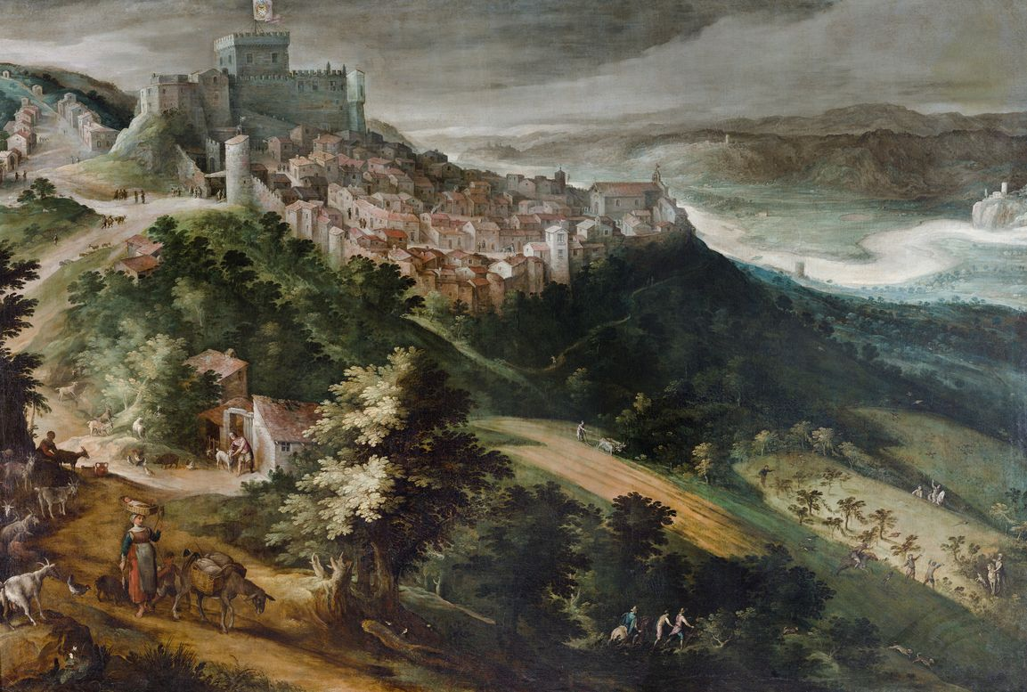
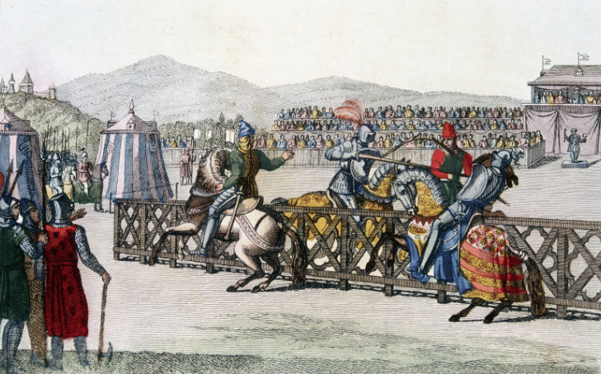
Game Concept In Echoes of Castles, you are a noble lord in a fractured medieval realm, where power is earned not only on the battlefield, but in the whispered halls of diplomacy and the roaring arenas of grand tournaments. Manage your fief, sustain your people, and forge (or break) alliances with rival houses. As unrest brews and war becomes inevitable, only those who master both steel and statecraft will survive.
Will your house rise to eternal glory—or be lost to the echoes of history?
Story The kingdom once stood united under a mighty crown, but the death of the High King shattered the realm into feuding territories. Now, ambitious lords claim dominion, each carving out their legacy through war, diplomacy, and ancient traditions.
You rule a once-thriving castle now on the brink of decline. Bandits harass the borders, the harvest wanes, and your vassals whisper of rebellion. Yet hope endures in the age-old Rite of Joust—a sacred tournament where honor can tip the scale of power.
As rumors of a dark alliance spread across the land, you must navigate betrayal, forge critical pacts, and lead your house through a storm of lances and lies.
Your legacy begins now.

Slide 5
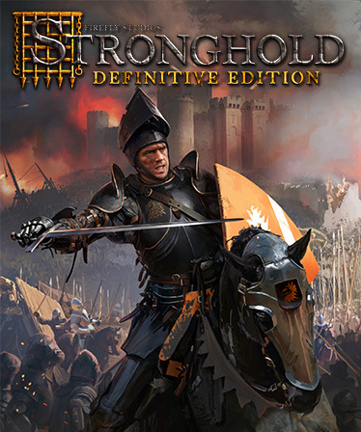
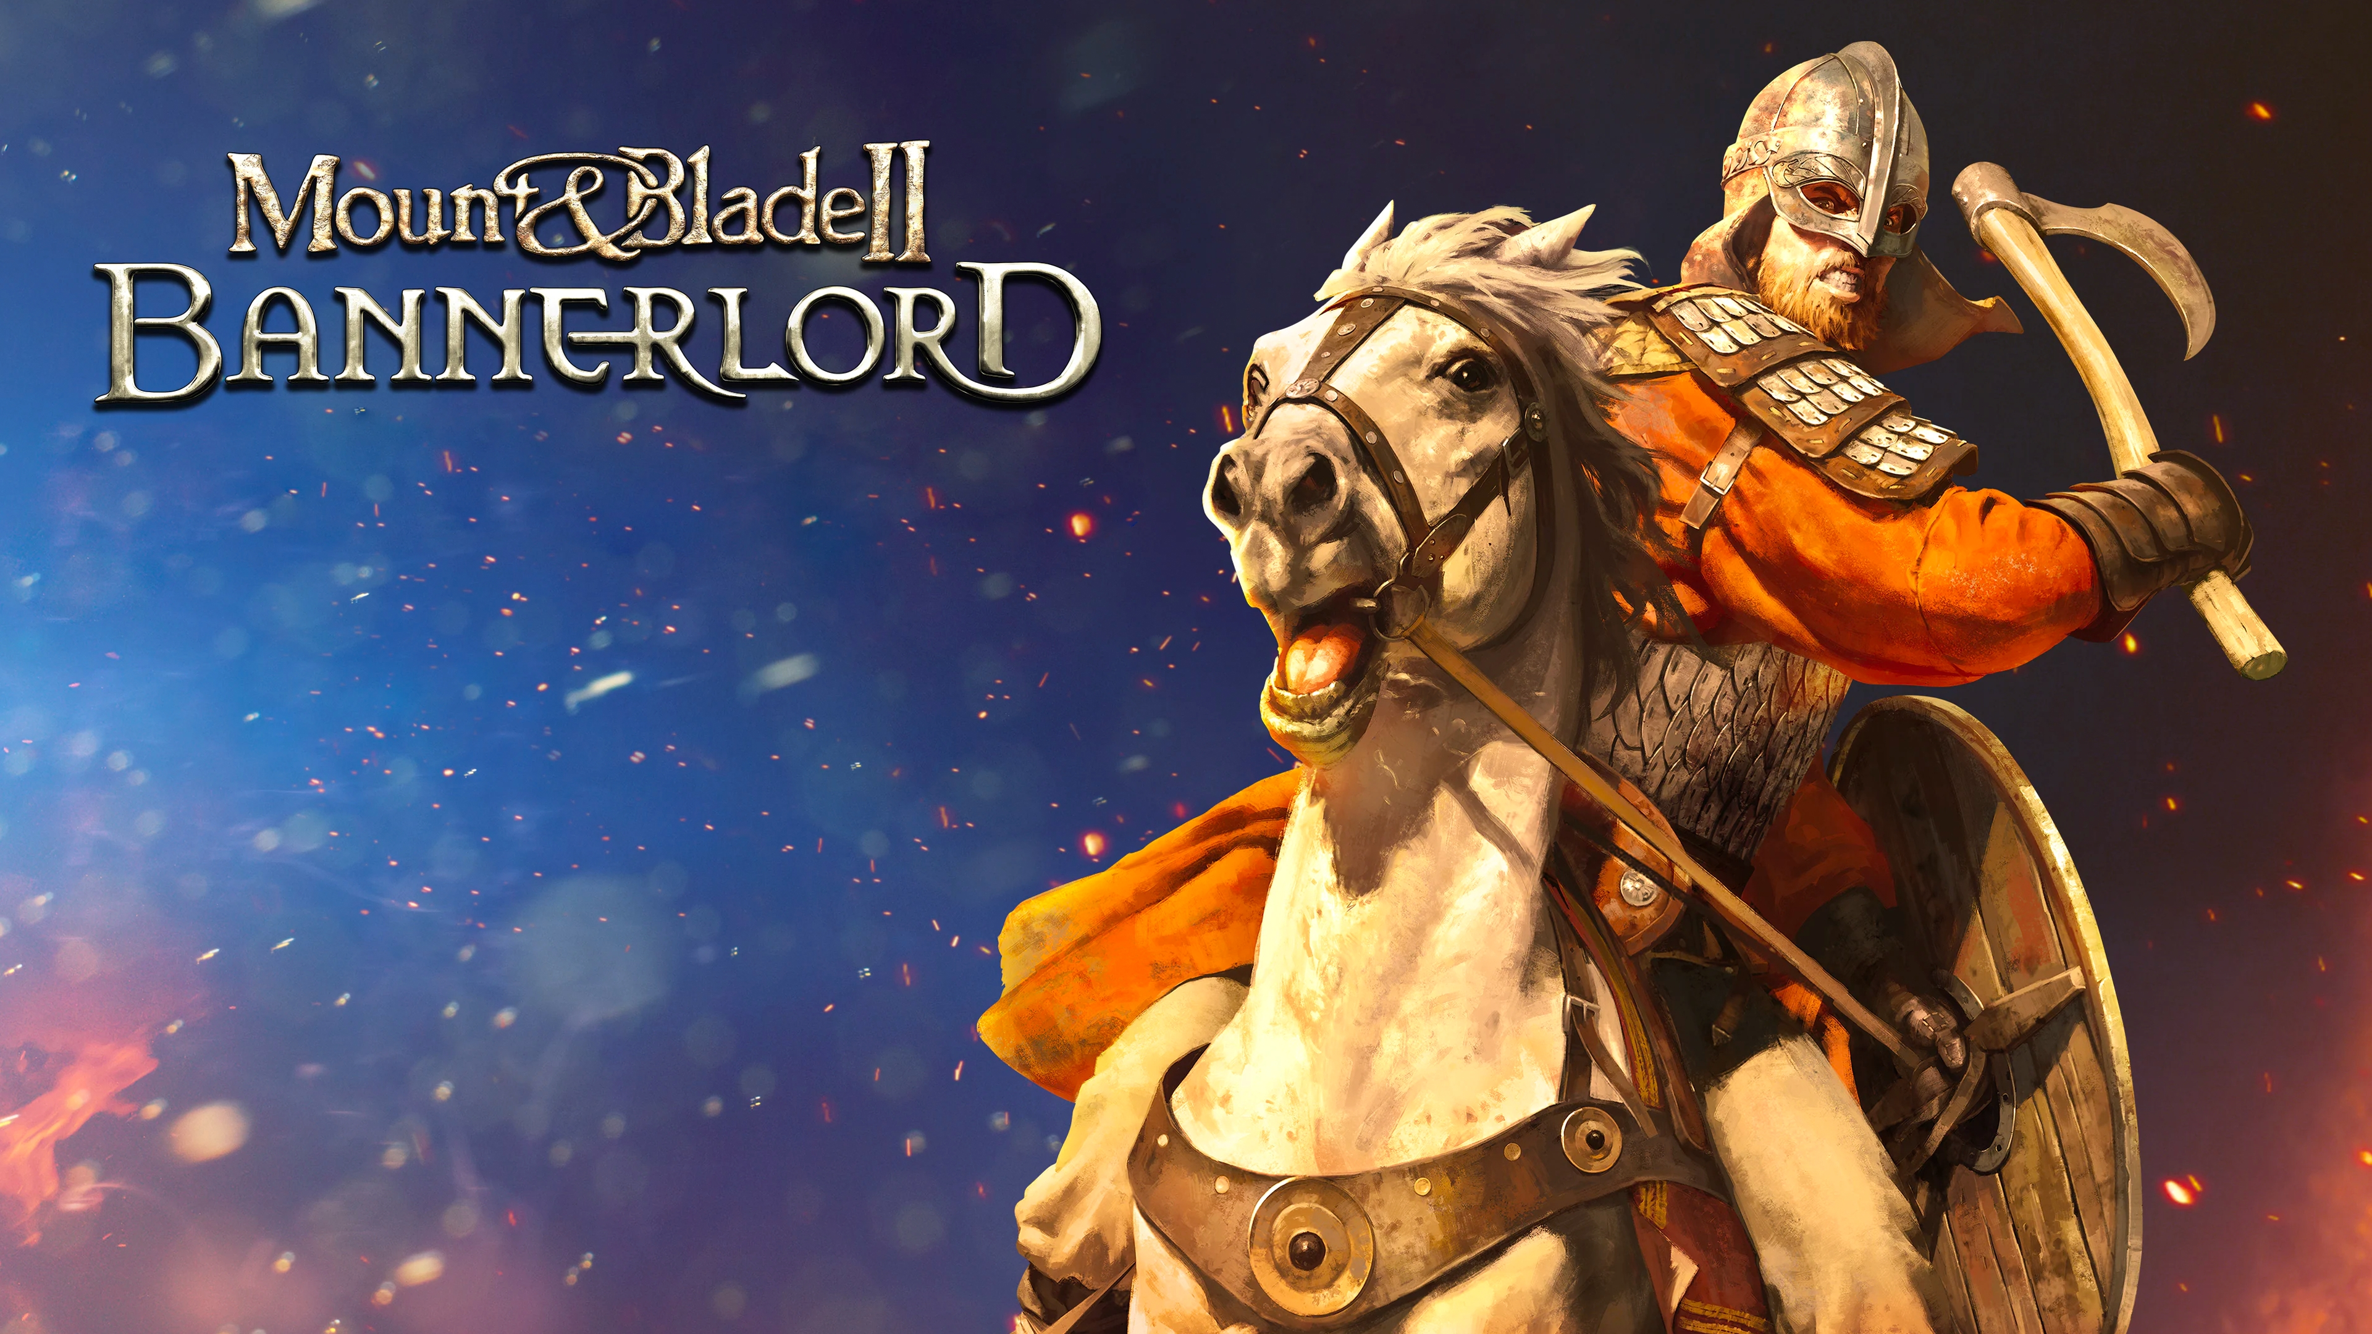
CREATIVE MIX
Stronghold For the management of the fief and its resources
Mount And Blade For the battles and the joust

Slide 6
GAME LOOP
Start of the turn
What happened the previous turn?
Diplomacy messages
Summary of the fief state
Fief management
Gather resources
Build or upgrade stuctures
Manage the politics
Diplomacy
Negotiate witht the lords
Build relationships
Events
Jousts and tournaments
Battles
Random events
End of the turn
Save progresses
Time advances

